Slide 1

What is GPU and “GPU computing”?
GPU = Graphics Processing Unit
GPU Computing
Computing using both CPU and GPU.
Why GPU computing?
Highly parallel nature of GPU
Reduced cost
Low power consumption
Cheap/Free Software availability
Parallel computing democratic
1

Slide 2
CPU and GPU suitability
CPU is perfectly suitable for processing small inherently sequential tasks.
GPU is suitable for large (Compute Intensive) data parallel tasks.
Serial portion
CPU
Time
Data parallel portion
GPU
Program
Serial portion
CPU
Data parallel portion
GPU
2

Slide 3
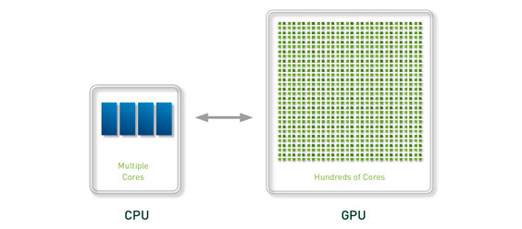
CPU and GPU architectural differences
Basis | CPU | GPU
No. of Cores | Few cores < 100 | Many cores > 100
Technology | Multi-core | Many core
Core Power | Very powerful and few cores | Less powerful but very large number of cores
Design philosophy | Few Elephants | Millions of ants
Clock rate | Very high | slow
Source: NVIDIA
3

Slide 4
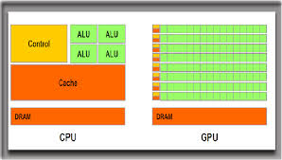
CPU and GPU difference
Source NVIDIA
-More transistors are used in CPU for control and cache
-More transistors are used for computations in GPU
4

Slide 5
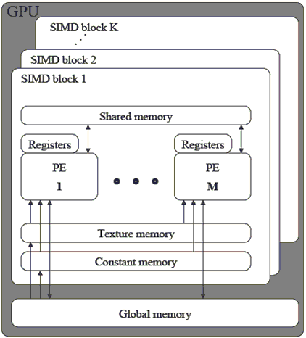
Architecture of modern GPU
A SM has 32 cores and 32767 registers
A Streaming Processor (SP)/Core.
( Primary thread processor)
A Streaming Multiprocessor (SM)
5

Slide 6
Architecture of Modern GPUs
Shared memory (on-chip)
GPU chip
Global Memory
Constant Memory
Multi-processors
GPU board
Off-chip memories
Processing Cores
6

Slide 7
CUDA
CUDA stands for Compute Unified Device Architecture. It is an extension of C/C++ programming.
CUDA is a programming language that uses the Graphical Processing Unit (GPU).
It is a parallel computing platform and an API (Application Programming Interface) model, Compute Unified Device Architecture was developed by NVidia.
This allows computations to be performed in parallel while providing well-formed speed. Using CUDA, one can harness the power of the NVidia GPU to perform common computing tasks, such as processing matrices and other linear algebra operations, rather than simply performing graphical calculations.

Slide 8
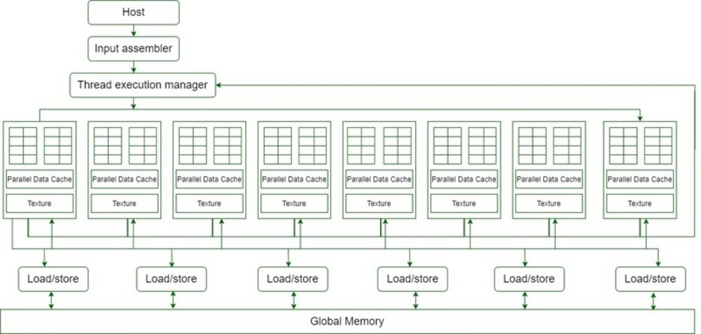
CUDA Architecture

Slide 9
CUDA Programming
GPUs are designed to perform high-speed parallel computations to display graphics such as games.
Use available CUDA resources. More than 100 million GPUs are already deployed.
It provides 30-100x speed-up over other microprocessors for some applications.
GPUs have very small Arithmetic Logic Units (ALUs) compared to the somewhat larger CPUs. This allows for many parallel calculations, such as calculating the color for each pixel on the screen, etc.

Slide 10
CUDA Programming
For data to be accessible by GPU, it must be presented in the device memory.
CUDA provides APIs for allocating device memory and data transfer between host and device memory. Following is the common workflow of CUDA programs.
Allocate host memory and initialized host data
Allocate device memory
Transfer input data from host to device memory
Execute kernels
Transfer output from device memory to host

Slide 11
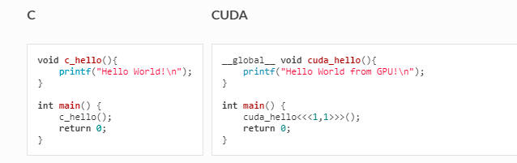
Simple CUDA Program

Slide 12
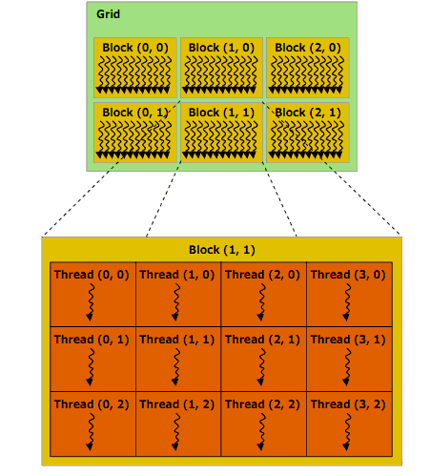
CUDA program Execution
Source: NVIDIA CUDA programming guide
12/31

Slide 13
16 Streaming Multiprocessor (SM) diagrams are shown in the above diagram.
Each Streaming Multiprocessor has 8 Streaming Processors (SP) ie, we get a total of 128 Streaming Processors (SPs).
Now, each Streaming processor has a MAD unit (Multiplication and Addition Unit) and an additional MU (multiplication unit).
The GT200 has 240 Streaming Processors (SPs), and more than 1 TFLOP processing power.
Each Streaming Processor is gracefully threaded and can run thousands of threads per application.
The G80 card supports 768 threads per Streaming Multiprocessor (note: not per SP).
Eventually, after each Streaming Multiprocessor has 8 SPs, each SP supports a maximal of 96 threads. Total threads that can run – 128 * 96 = 12,228 times.
Therefore these processors are called massively parallel.
The G80 chips have a memory bandwidth of 86.4GB/s.
It also has an 8GB/s communication channel with the CPU (4GB/s for uploading to the CPU RAM, and 4GB/s for downloading from the CPU RAM).

Slide 14
Working of CUDA
GPUs run one kernel (a group of tasks) at a time.
Each kernel consists of blocks, which are independent groups of ALUs.
Each block contains threads, which are levels of computation.
The threads in each block typically work together to calculate a value.
Threads in the same block can share memory.
In CUDA, sending information from the CPU to the GPU is often the most typical part of the computation.
For each thread, local memory is the fastest, followed by shared memory, global, static, and texture memory the slowest.

Slide 15
CUDA Applications
CUDA applications must run parallel operations on a lot of data, and be processing-intensive.
Computational finance
Climate, weather, and ocean modeling
Data science and analytics
Deep learning and machine learning
Defence and intelligence
Manufacturing/AEC
Oil and natural resource
Medical imaging

